Slide 1

NLP and Word Embeddings
Learning word embeddings
deeplearning.ai

Slide 2















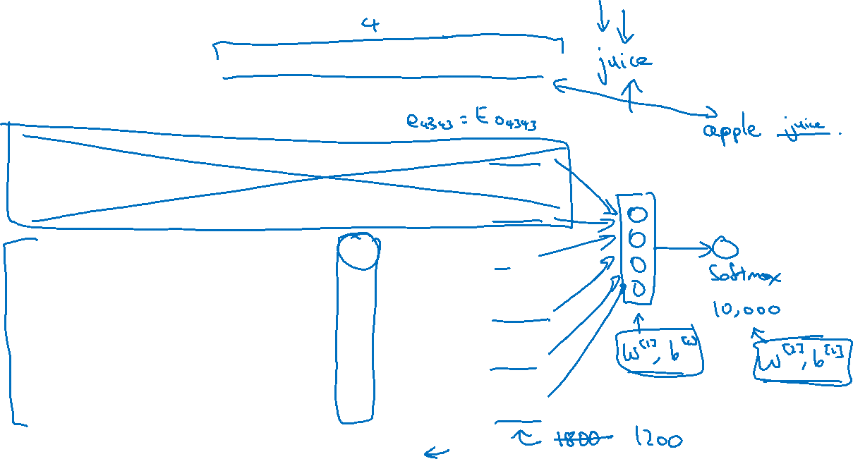





Neural language model
I want a glass of orange ______.
$$4343$$
$$9665$$
$$1$$
$$3852$$
$$6163$$
$$6257$$
I
$$o_{4343}$$
$$E$$
$$e_{4343}$$
want
$$o_{9665}$$
$$E$$
$$e_{9665}$$
a
$$o_{1}$$
$$E$$
$$e_{1}$$
glass
$$o_{3852}$$
$$E$$
$$e_{3852}$$
of
$$o_{6163}$$
$$E$$
$$e_{6163}$$
orange
$$o_{6257}$$
$$E$$
$$e_{6257}$$
[Bengio et. al., 2003, A neural probabilistic language model]

Slide 3
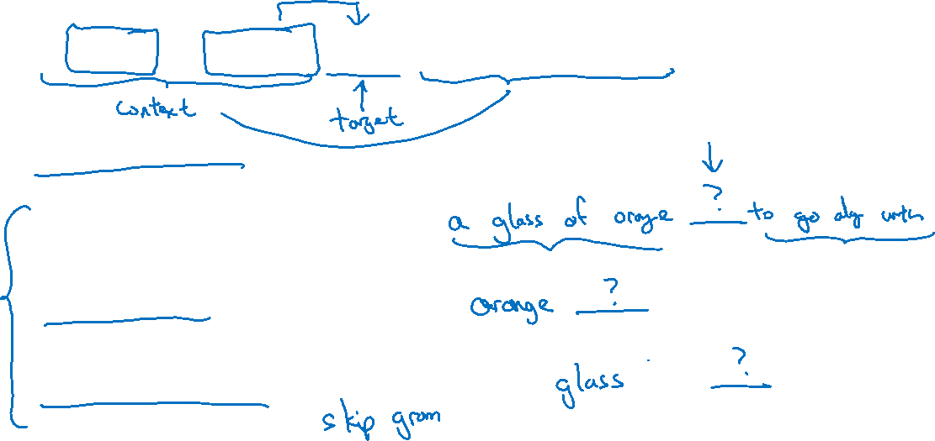
Other context/target pairs
I want a glass of orange juice to go along with my cereal.
Context: Last 4 words.
4 words on left & right
Last 1 word
Nearby 1 word

